Slide 1
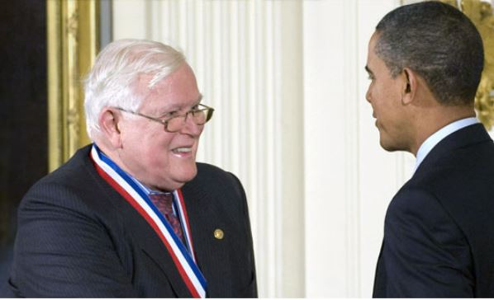
KALMAN FILTERING
“A New Approach to Linear Filtering and Prediction Problems” – 1960 (R. E. KALMAN)
“New Results in Linear Filtering and Prediction Theory”-1961 (R. E. KALMAN ,R. S. BUCY )
RUDOLF E. KALMAN (1930 – 2016)
Presented by:
Vimal Jaswal - B00122875
Masters of Engineering in Internet of things technologies
TU Dublin, Blanchardstown, Ireland.
Source: https://www.eng.ufl.edu/newengineer/in-memoriam/remembering-rudolf-e-kalman-1930-2016/

Slide 2
Introduction
Research paper by Rudolf E. Kalman in 1960
A set of mathematical equations
Recursive data Processing Algorithm
No need to store all previous measurements and reprocess all data each time
Optimal estimation
minimum mean square error in results between actual parameters and predicted
Versatile
Estimation
Filtering
Prediction
Fusion

Slide 3
Kalman Filter
Kalman filtering
uses a series of measurements observed over time, containing statistical noise and other inaccuracies and produces estimates of unknown variables that tend to be more precise rather than on basis of single measurement.
Implemented on the Apollo Project in 1961 - space navigation problem
Advantages
Optimal estimator
Provides a precise measurement for noises present in the system
Handles missing data
Handles the large uncertainty of the initialization phase
Fuses information from multiple-sensors

Slide 4
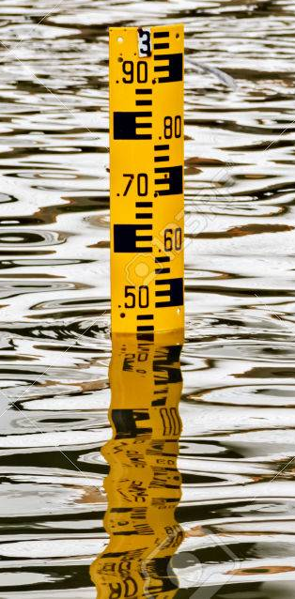
Kalman Filter Concept
Hydrologic model that predicts water level in a hydro-dam every hour (model is not perfect)
A person also checks the water level (not perfect)
Combine both case results of water level from model and person’s measurements to get a “fused” (average) and better estimation of correct water level
Kalman filtering
Kalman filter - prediction process and the measurement process
Both processes are combined and operated in a recursive manner to achieve optimal Kalman filtering process

Slide 5
Kalman Filter Applications
Kalman Filter is a sensor fusion and data fusion algorithm used for:
State Estimation and multiple Sensors Fusion
Wireless sensor network (WSN), Localization, Tracking
Guiding Systems, Navigation, GPS
Autopilots
Radar Tracking Systems
Orbit tracking, trajectory tracking
Simultaneous Localization And Mapping (SLAM)
State estimators for Unmanned Aerial Vehicles (UAV)
Computer Graphics - 3D Modelling feature estimation

Slide 6
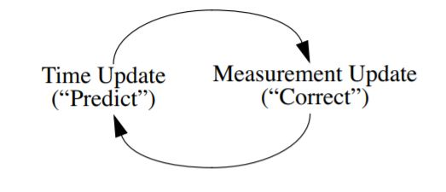
Discrete Kalman filter (Predictor- Corrector)
The Kalman filter estimates a process by feedback control: the filter estimates the process state at some time and then obtains feedback in the form of (noisy) measurements.
Time update equations and measurement update equations

Slide 7
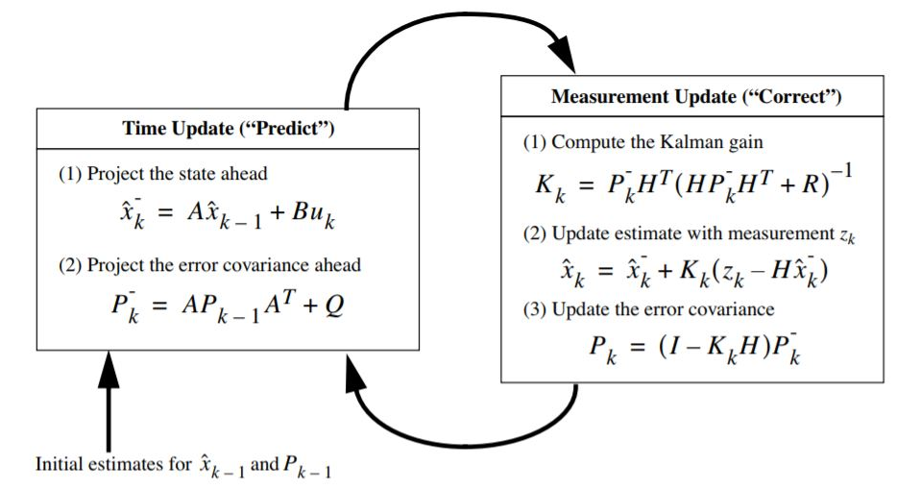
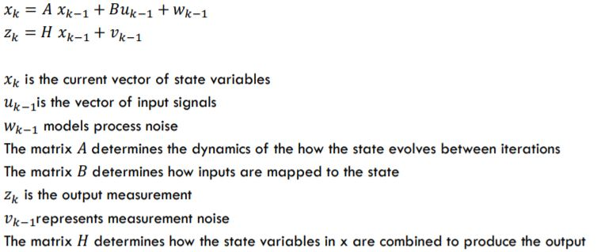
Discrete Kalman filter (Predictor- Corrector)
Q - process noise covariance R- measurement noise covariance
(Co- variance noise matrices might change with each time step/measurement/iteration)
P- covariance matrix of error in state estimate x
K- Kalman gain depend upon P and Q co-variances and H matrices
K changes in every iteration and determine weight for each prediction
posteriori estimate
priori estimates for the next time step

Slide 8
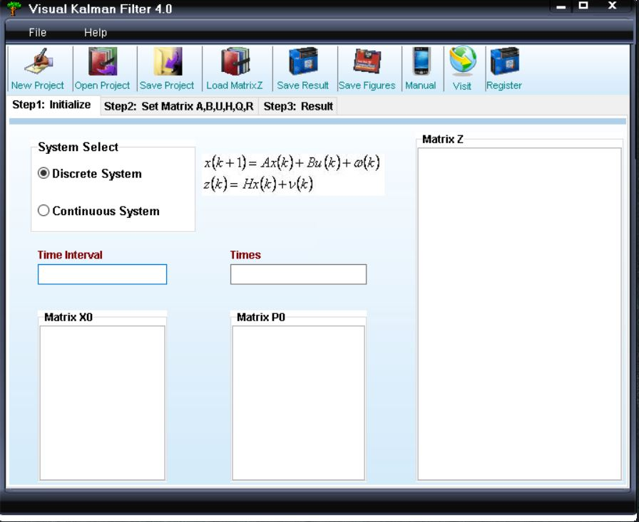
Kalman Filter Software Tools
Visual Kalman Filter
Kalman filtering designer that provides a visual method in windows to estimate the state of a process or removes noise from series of data
Support for discrete system and continuous system
Easy, lite and handy to use
MATLAB (Built-in features, EKF/UKF Toolbox for MATLAB V1.3)
GNU OCTAVE ( Autocovariance Least-Squares (ALS) Package tool also works with MATLAB

Slide 9
Kalman Filter MATLAB
Kalman
Syntax: (Kalman filter design, Kalman estimator)
[kest,L,P]=kalman(sys,Qn,Rn,Nn) [kest,L,P] = kalman(sys,Qn,Rn,Nn,sensors,known) [kest,L,P,M,Z] = kalman(sys,Qn,Rn,...,type)
Kalmd
[kest,L,P,M,Z] = kalmd(sys,Qn,Rn,Ts)
configureKalmanFilter (Kalman filter function for object tracking)
kalmanFilter=configureKalmanFilter(MotionModel,InitialLocation,InitialEstimateError,MotionNoise,MeasurementNoise)

Slide 10
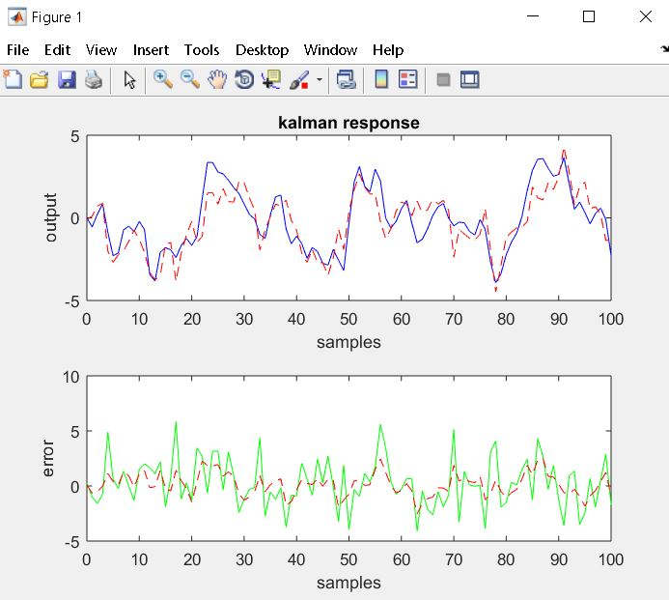
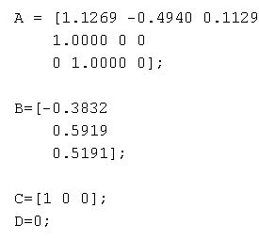
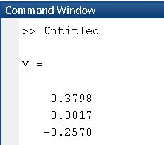
Kalman Filter MATLAB
Example making steady state filter for plant:
X(n+1)= A x(n)+ B u(n) y(n)= C x(n)
Let yv[n] be a noisy measurement of the
output y[n], with v[n] measurement noise:
yv[n]=y[n]+v[n]
Time Update equation:
X(n+1|n)= Ax(n|n-1) + Bu(n)
Measurement Update equation:
X(n|n)= x(n|n-1) + M((Yv(n) – Cx(n|n-1))
Source: https://www.mathworks.com/help/control/ug/kalman-filtering.html

Slide 11
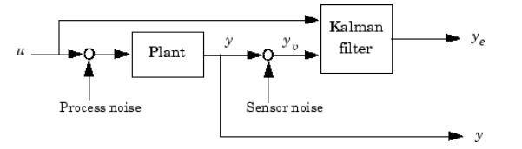
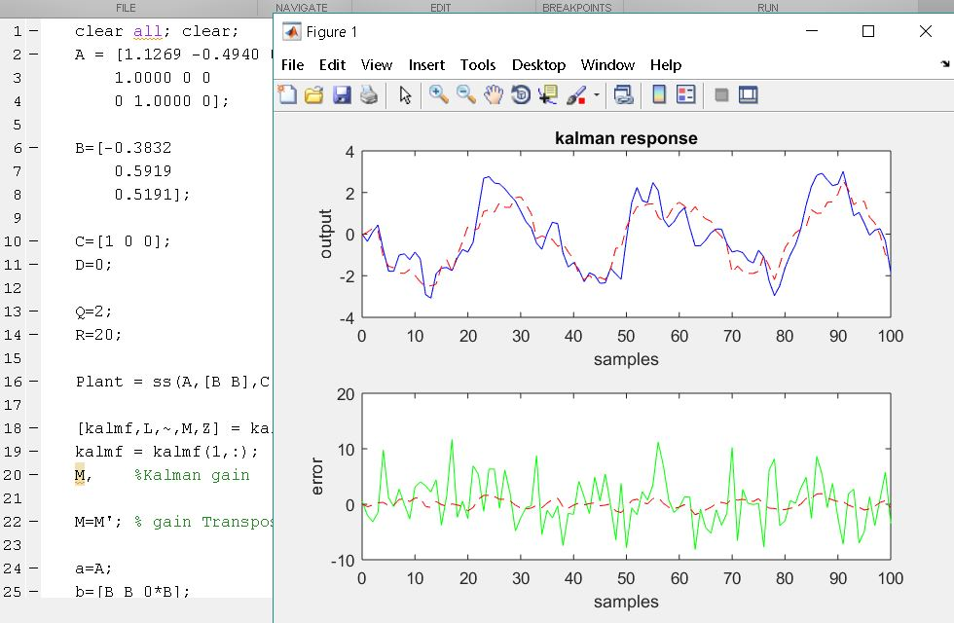
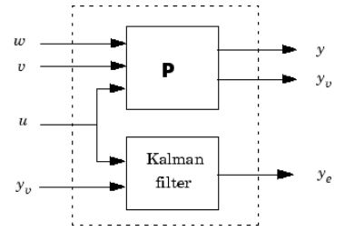
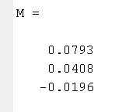
Kalman Filter MATLAB
Source: https://www.mathworks.com/help/control/ug/kalman-filtering.html

Slide 12
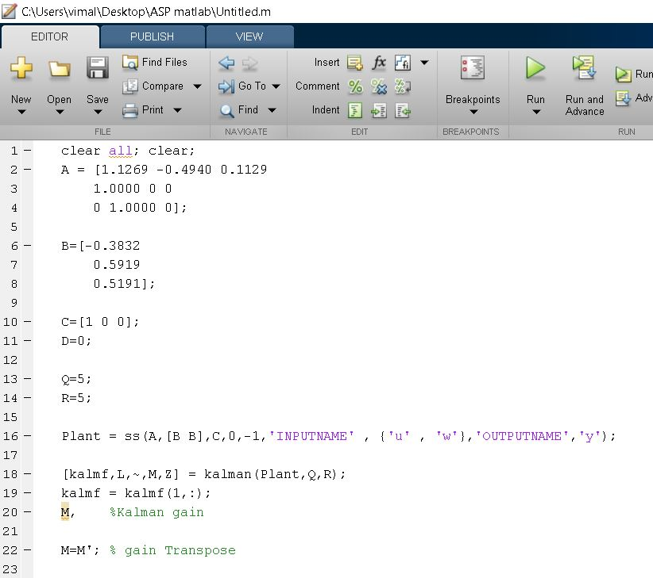
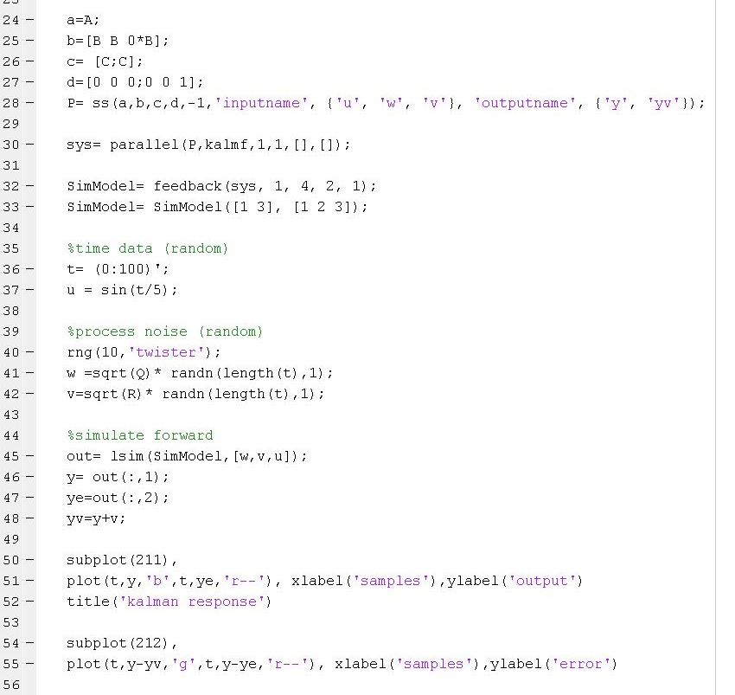
Kalman Filter MATLAB

Slide 13
Refrences.
[1] Welch, G and Bishop, G. 2001. “An introduction to the Kalman Filter”, [Online]. Available: http://www.cs.unc.edu/~welch/kalman/ [Accessed: 03- Apr- 2019].
[2]M. Hayes, Statistical digital signal processing and modeling. New Delhi: Wiley, 2014.
[3]"Kalman Filtering- MATLAB & Simulink", Mathworks.com, 2019. [Online]. Available: https://www.mathworks.com/help/control/ug/kalman-filtering.html. [Accessed: 03- Apr- 2019].
[4]"Visual Kalman Filter - Kalman filter designer for Windows", Luckhan.com, 2019. [Online]. Available: http://www.luckhan.com/kalman-filter-design.htm. [Accessed: 03- Apr- 2019].

Slide 14
Thank You

